Slide 1
Project Design G.O.A.T.
Peyton V.
Peyton W.
Sean H.

Slide 2
What is the G.O.A.T?
GOAT stands for “go on and try.”
It is a service for those looking for the perfect media to indulge in based on their searches and ratings.
A user may search a specified media and be shown other media that they may enjoy based on descriptors of said media title.
Media includes books, movies, and video games.

Slide 3
Media Test
As previously stated this prompt is optional and only experienced on sign up.
The user is given a “cold case” of media and is prompted to rate them.
Used to gain information for better recommendations.
If user has not experienced media, they may skip them and be prompted with a different title.
If skipped, the users specific ratings are used to decipher better recommendations.

Slide 4
User Class
A user class is used to store user specific data.
User ID
Username
Password
Email
etc…
This data will be retrieved on a successful login from the database, then passed to the preferences class used by Java.

Slide 5
Profile
The user profile will consist of the user data.
All information will be gotten from the user preferences and be displayed neatly.
The user will have the option to
Change profile picture
Change password
Logout
Options to switch to media screens
See rated and saved list

Slide 6
Home
Home screen is where the GOAT algorithm does its work.
Profile information is used to pick genres of the users greatest interest.
Ratings list plays largest role.
The media are displayed:
Picture
Media Title
Rating

Slide 7
Search List
Once an item is searched, the user is lead to the Search List Screen.
Users have the option to choose a Basic or Advanced search.
The Title searched is run through the recommendation algorithm.
The top relevant Media are displayed.
Includes:
Title
Picture
Genre(s)
Description
Rating

Slide 8
Media JSON Objects
Objects that consist of an item array that will have different values depending on what media type the user is trying to recieve.
Objects will be received in
Media screens on load
Profile list view screen
Search submissions
Pull of rated and saved list

Slide 9
Pulling Rated and Saved Lists
Both work the same way.
A User ID is sent to find their specific list of rated or saved media.
What is received is a JSON object based on media type
i.e. book, movie, video game
To make data easy to process the JSON object will be in array format.

Slide 10
Media Item
A media item has
Picture
Title
Rating
Genre
Media Items are shown in the home screen or the load in screen.
Pulled from the database by the recommendation algorithm.

Slide 11
Basic Search
Basic searched is used to get back more than 1 title. This is used for titles that are the same.
Ex: If searched Footloose it will get back all the footloose movies no matter the date released.

Slide 12
Advanced Search
The advanced search is used when the user wants a specific media. With titles being the same. The user will provide exact information to grab the specific media.
Movies advanced search
Title
Date released
Book advanced search
Title
Author
Date released
Video game advanced search
Title
Date_released
Console

Slide 13
Recommender
Sends:
Array of media ID’s
Maximum number of items returned
Minimum association value of items returned
Receives:
Array of pairs
Media ID’s with association value

Slide 14
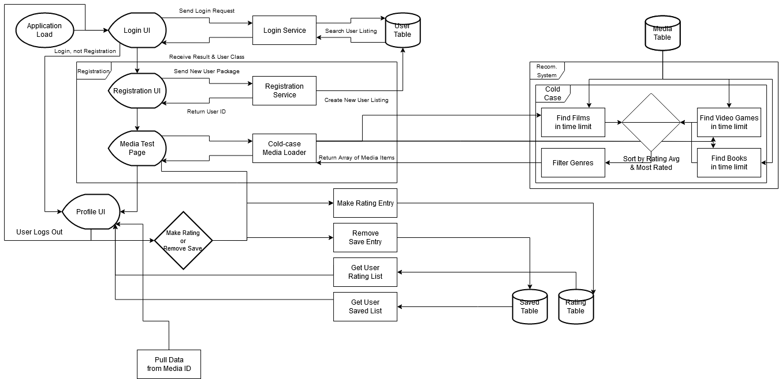
Login and Sign Up System

Slide 15
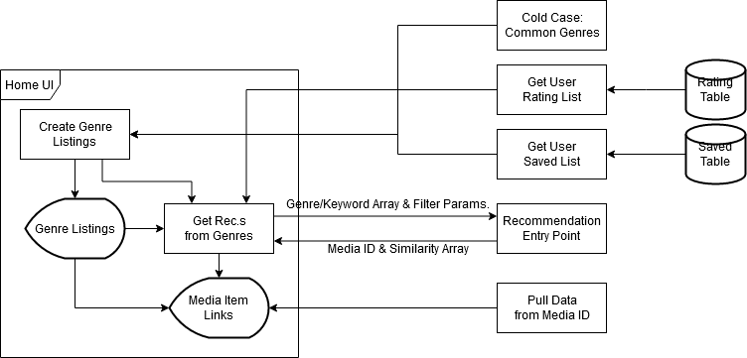
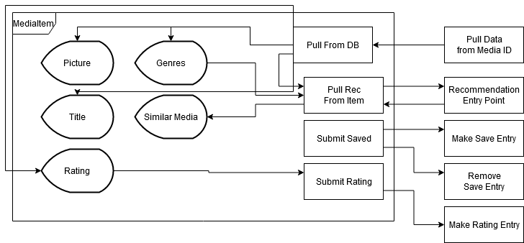
Home
Media Item

Slide 16
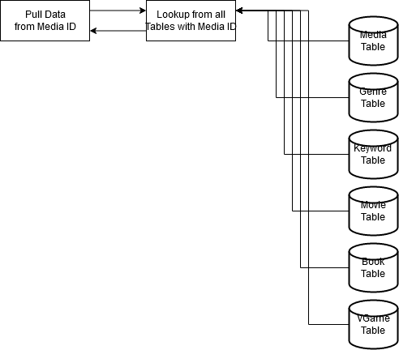
Getting data from the database

Slide 17
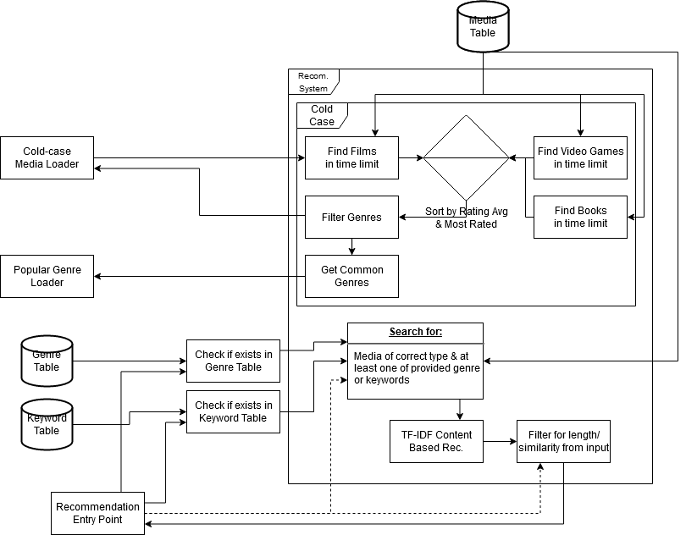
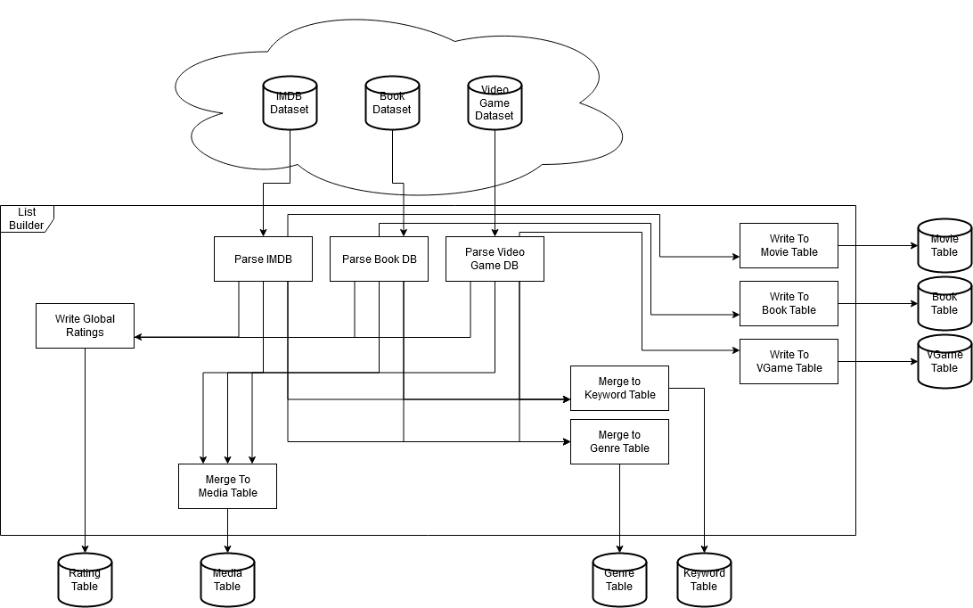
Recommendation System
Table Builder

Slide 18
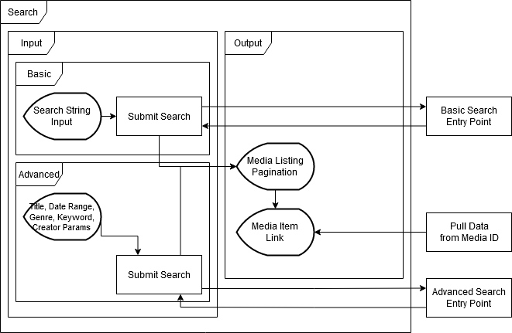
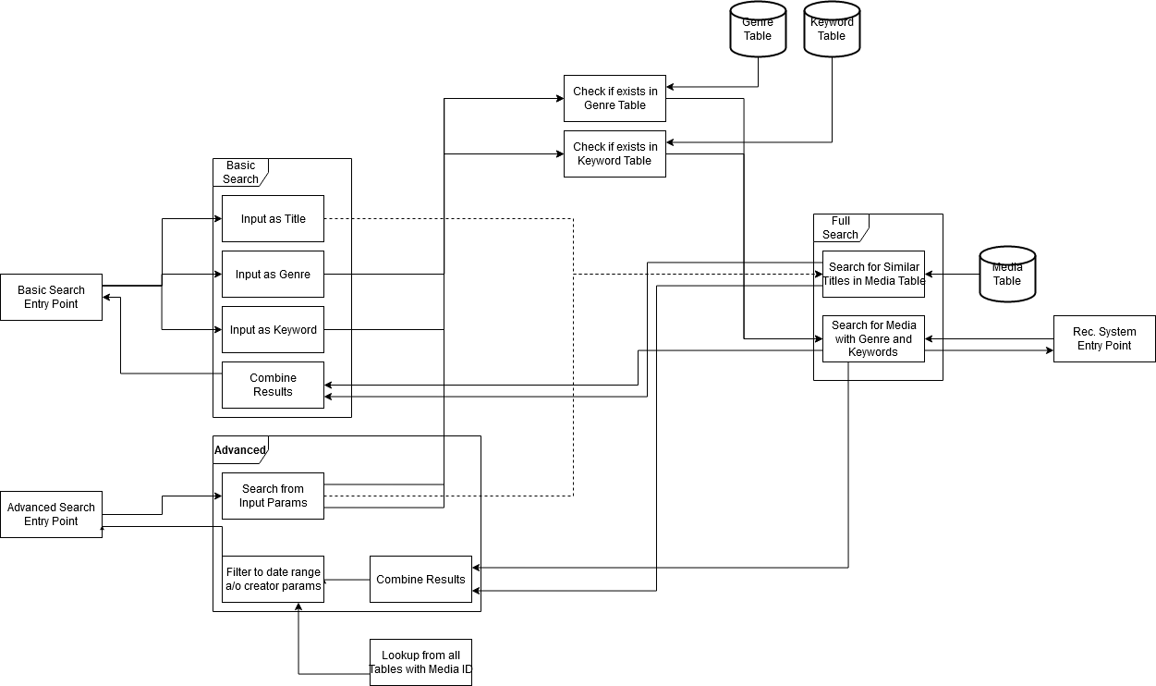
Front end search
Back end search

Slide 19
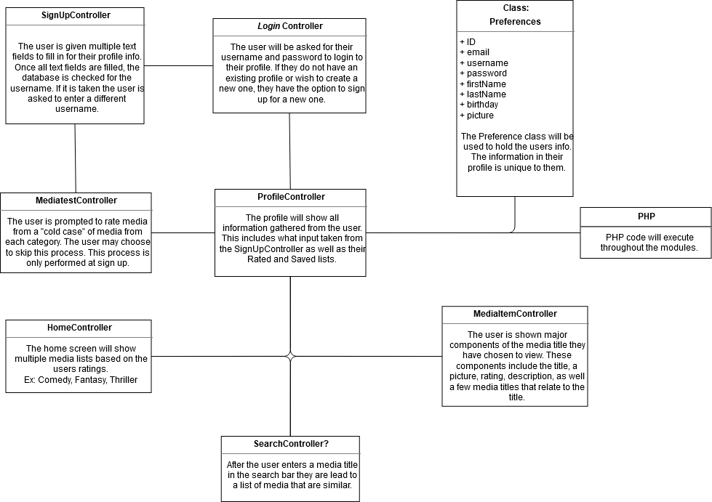
Front end Java

Slide 20
